Slide 1
Making Your One-on-Ones More Meaningful and Impactful
Notes:
Moving in a step deeper to see how we can make the O3 Conversation meaningful and maximize our impact as a leader of people.

Slide 2




Meaningful and Impactful O3 conversations
Time
Purpose
Role
Place
Building Trust-Based Relationships
Notes:
2 minute.
4 pillars appear in animation.
To build trust with your team members through your O3 conversation, 4 things matter most – the time we spend, the purpose of the conversation, your role in this conversation and the environment where the conversation is taking place.
Let’s look at them one by one…

Slide 3
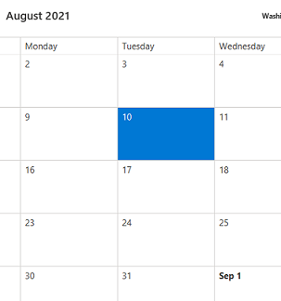
Time: When and How Long?
O3
03 with Tanuka
Every Week – Every Week
Manager Scheduled - On the calendar – standing meeting (Rarely missed and never cancelled)
Between Monday second half and Friday first half (Sweet spot – Tuesday to Thursday)
30 minutes
O3
O3
03 with Nidhi
O3
03 with Vishal
Put the One-on-Ones on Your Calendar
03 with Sharon
Notes:
10 minutes
Time – it has to be weekly. Not monthly, not fortnightly, WEEKLY. Research has shown that when you do a weekly O3 vs. a fortnightly, the Manager’s impact goes down by almost 40%.. Manager who were doing a fortnightly O3, were 40% behind the Managers who had their O3s every week.
During the research, managers who were doing Monthly O3s were compared to Manager who were doing No O3s, and surprisingly, the Managers with no O3 ritual were better off than the ones with a monthly rigor. So if you plan to do a monthly O3, don’t do it at all. The supervisees/manages of these managers said I don’t even know if I’ll be on the same project or how the context would have changed, there’s just no continuity to my conversation with my Manager..
It has to be scheduled by You. Don’t ask your manage to find time on your calendar. When you set it up, it sends a message, it tells people that they matter. They are valued and that you, their boss is committing a time to them. Make it a standing meeting. Your and their time commitment to each other.
The sweet spot to fix these are between Tuesday and Thursdays.. Mondays are usually tough days for everyone.. And if you get pulled into something on Friday, you’ll miss an entire week. Tuesdays, Wednesday, Thursdays give you an opportunity to reschedule if needed, it saves you the agony of missing a week.
30 minutes.. Unless you are the CEO, or a senior business leader driving few divisions, 30 minutes are enough.. Its again a good time frame to discuss all that you need.

Slide 4

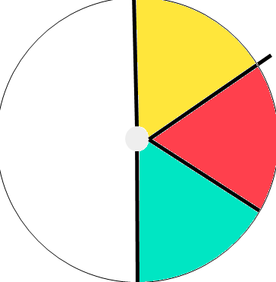
Purpose: What Will the Conversation be About?
Their 10 minutes
Whatever they want to talk about
They all will be different, some could be same
Your 10 minutes
Whatever you want to talk about – it’s usually work
10 minutes for future
Coaching
Career Plans
Them
You
For Future
Team Member’s Issues are Primary
Notes:
10-12 minutes
Remember, it is the team member who is at the center of this conversation,.. Let the team member know that he/she has to start the conversation. She/he can chose anything they want to talk about.. It could be work, and that’s okay. It could be family, personal, aspirations, milestones, gratitude.. Anything.. It’s their spot.
First few instances of your O3, people may only want to talk about work. Some of them may not have an experience for this structure and that’s okay. Let them start with that if that gives them comfort.
Important for you- if they talk about family, you may also talk about family, but don’t take the pressure/burden to always mirror the topic. Your 10 minutes are yours. You want to talk about work/family whatever, its your sacred space… most managers speak about work, what you expect, what went over the last week
While the recommendation for the last 1 minutes is to speak about future, their growth, your plans any learning opportunities etc.. Many a times it may not happen.
Research with managers showed that almost 90% of the times, they will speak for 12-15 mins. And the manager speaks for about 12 – 14 minutes and that’s about 25-28 minutes.. You may not always save time.. And that’s okay…. Most important is giving space to the employee to talk and finish their topic.
There’s a high chance that the Last 10 mins may not happen in the first few O3 conversations at all.. But its your job to bring this up…

Slide 5

Role: What Will I Do?
First 10 Minutes
Engage in active listening
Take notes (handwritten are best)
Your 10 minutes
Discuss about work, be concise and direct
Anything on your mind
Listen Well and Make Notes
Notes:
10 minutes
Your main role is in this conversation is to Bring your authentic presence. Be genuine about investment in the team member. Take interest. We humans are smart, we find out if you’re there, present truly or not and the purpose gets defeated if you are distracted.
So listen well and make notes.. Ask follow-up questions if you don’t understand something, give verbal cues, engage in the conversations.
Make notes, keep a separate diary/journal for these notes.. You should be able to see the progress of the employee.. It shouldn’t be a treasure hunt when you have to find something about the employee.
Tell the team member that you will make your notes and write it in..
Avoid e-notes, because when in a virtual space, we’re unable to differentiate if you are making notes or responding to emails or coding. And if that message goes out to the team member, you lose their trust.. You don’t want that.

Slide 6

Place: Where Will I Have the Conversation?
Remotely
Must to be on video
Peaceful space
Distractions are okay – Kids, Pets, Interruptions
In Person
Someplace comfortable
Over a coffee
Don’t book a conference room
War-rooms are okay
Be There a 100 percent
Notes:
5 minutes
In the remote environment like ours, use video, it shows your presence their 100%. It helps you also to gauge the team member’s emotions, facial expression, if they’re unsure, or confident or are acknowledging you and the conversation.
It’s okay to be distracted by family around you, but make it a peaceful space.. Make it a coffee conversation if it gives both of you comfort.
Whenever we get back to office and you continue this ritual, avoid large conference rooms or very noisy areas.. Again a coffee connect at a war room, smaller cubicle is perfect.

Slide 7

Your Next Steps
Block time right now
Inform your people what you are going to do
Start at the earliest
Notes:
5 minutes. -
We’re holding this space for you ,take 2 minutes and block One-on-One with 2 people on your team right now.. Put in a recurring meeting.
In your next standup / or write an email to the team that you will be scheduling these with them.
Don’t wait too long.. Start with micro-steps, book a couple of them now.. Start with one – two in first week, cover all in the second week.. It’s like starting to go to gym.
If you need help – paste this text in the chat window and give to the participants to roll out to their teams.

Slide 8

The Key Takeaways
Put the one-on-ones on your calendar
Team member’s issues are primary
Listen well and make notes
Be there a 100 percent
Notes:
Summary – 2 minutes
Summarize the session with this slide, take any last questions.

